Slide 1
Competitive Cyber Security Organization
Physical Security Workshop
By attending today’s meeting you acknowledge that you may be photographed or recorded for club use

Slide 2
Learning Objectives:
Nondestructive Entry
Lockpicking brief + demo
Hands on time during other talks
Vehicle Security
Alarms + Handcuffs
Social Engineering
SERE

Slide 3
Safety Disclaimer
We're teaching skills for the purpose of education and protection
Know the law; depending on your state some of these tools carry a felony for simple possession or intent
Some techniques may cause damage, do not practice on equipment that you don't own
We do not endorse any criminal activity

Slide 4
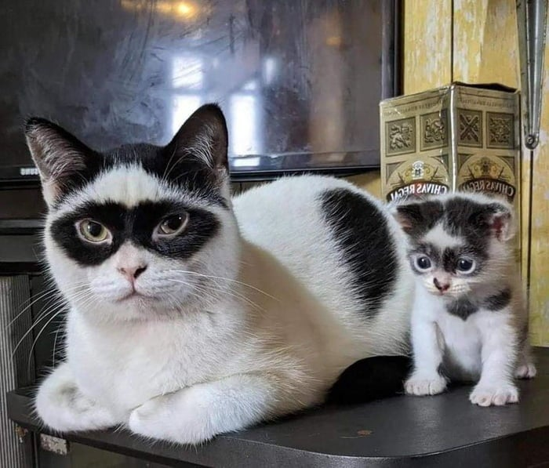
Nondestructive Entry w Liam :)
Lockpicking, Bypassing Locks and Doors

Slide 5

Learning Objectives
Types of locks
Lockpicking
Single pin
Rakes + Tools
Bypassing locks
Shims
Traveler's hooks
Door mechanisms

Slide 6
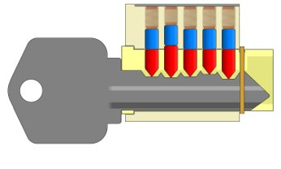
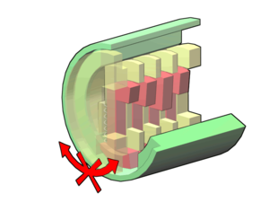
Common Lock Types
Pin and Tumbler
Most doors in the US
Wafer
Cars, Lockers
Tubular
Bikes, Vending Machines
Disc Detainer
Warded
Lever

Slide 7
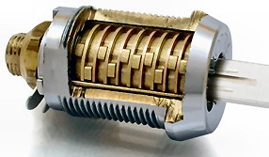
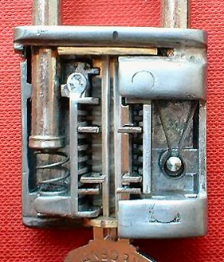
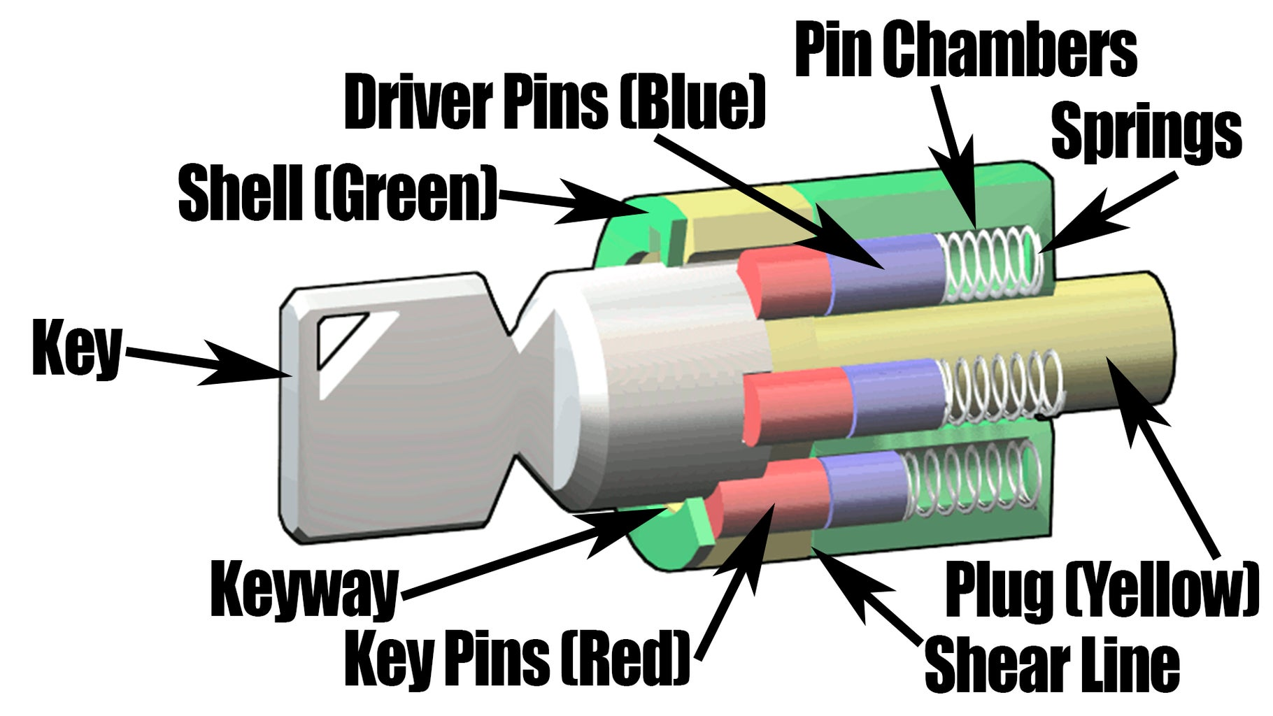
More Lock Pictures

Slide 8
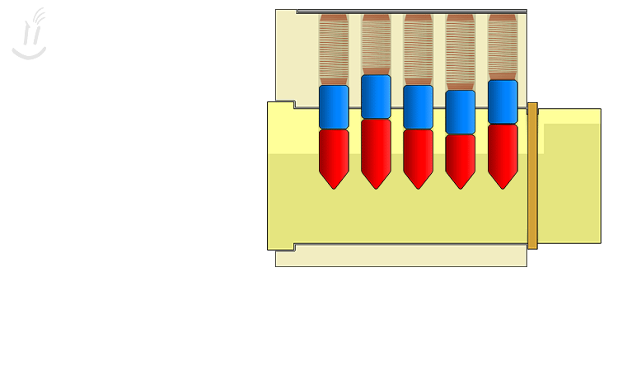
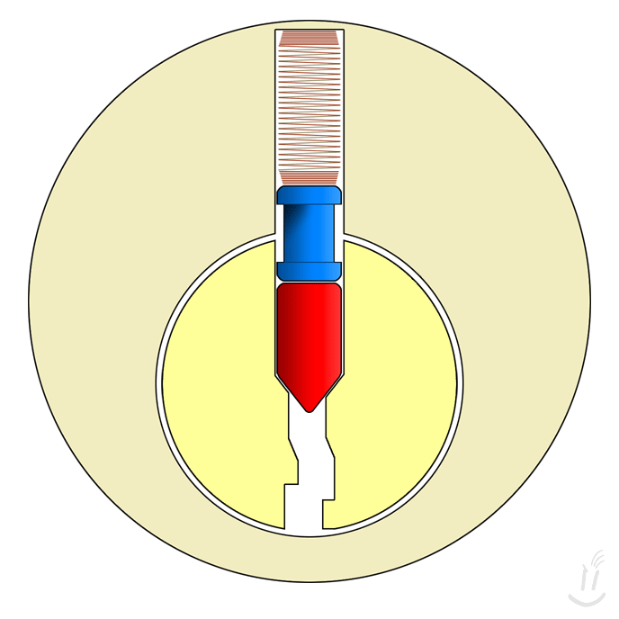
Pin Tumbler Locks
Cylinder, Keyway, Driver Pin, Key Pin, Springs
Keys move pins to the shear line + turn the lock
Security pins + anti picking measurements

Slide 9
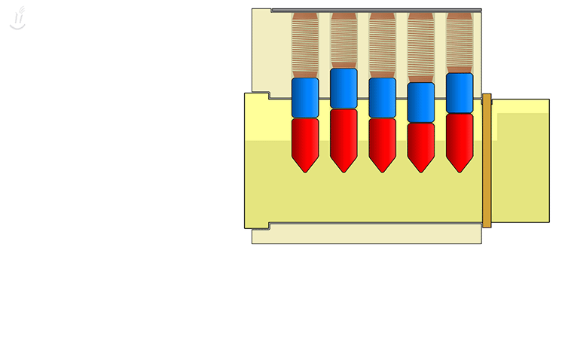
Picking Pin Tumbler Locks
Preys on manufacturing tolerances
Apply turning force
Go through pins until they bind
Rinse and repeat

Slide 10
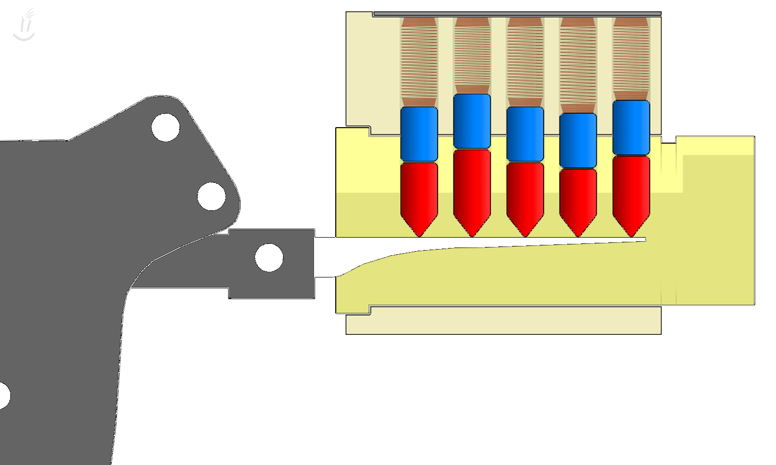

Rakes, Jigglers, and Bumping
Not precise, quickly move pins into position

Slide 11
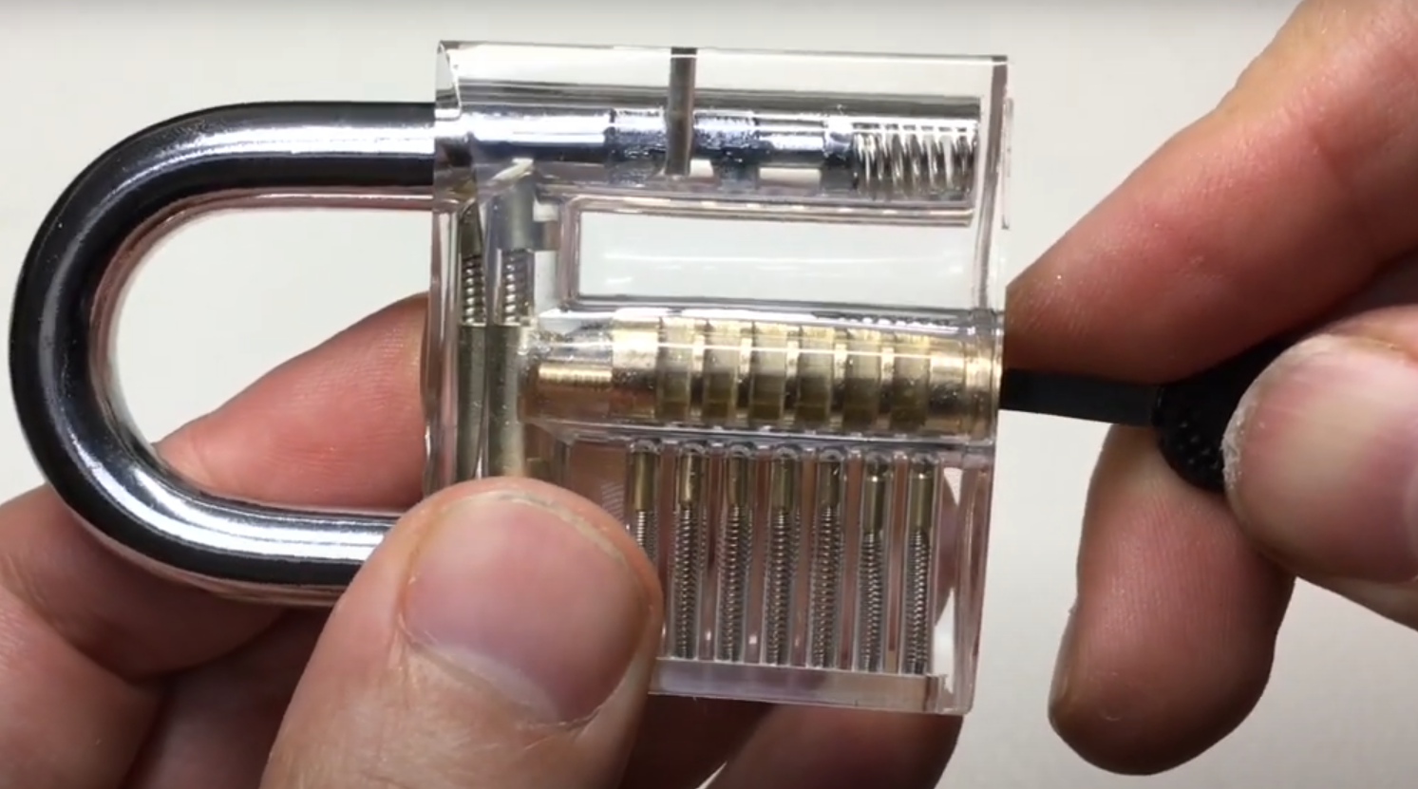
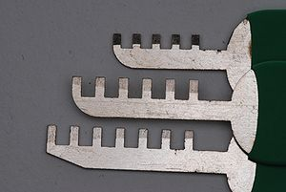
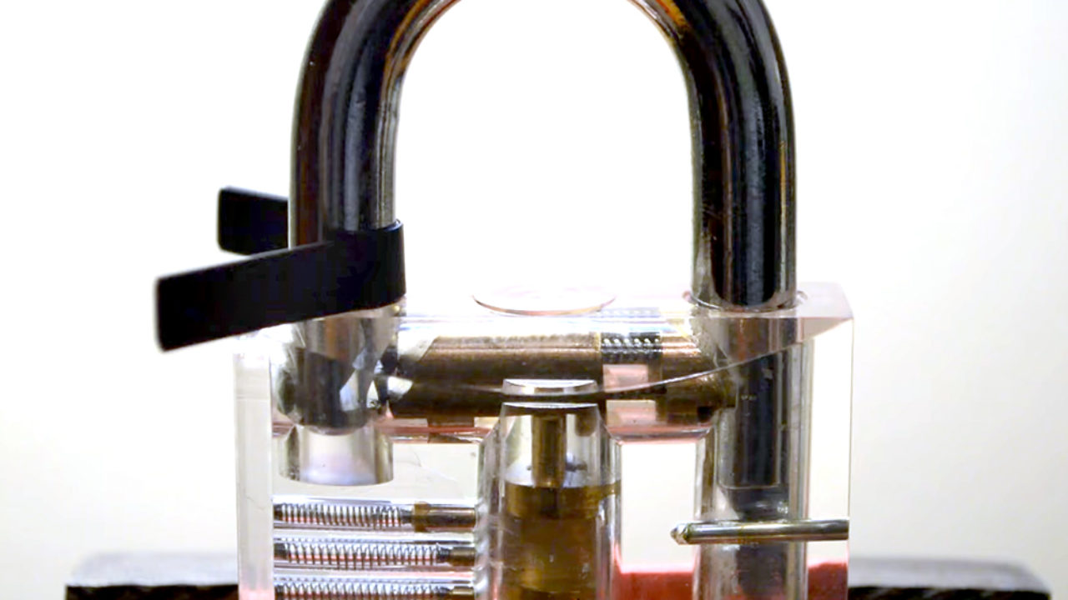
Bypassing Locks
Unshielded keyways
Combing
Padlock Shimming
Decoding + Impressioning

Slide 12



Bypassing Doors
Doors that open away from you
Shims
Doors that open towards you
Jims
Traveler hooks
Under the door tools
Air Wedges

Slide 13

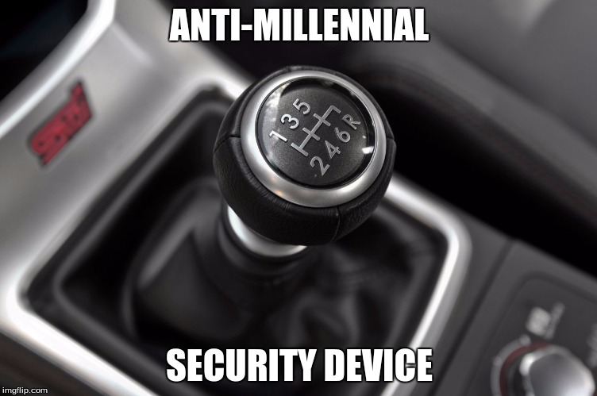
Vehicle Security w Evan :D
Bypassing Vehicle Security

Slide 14

Learning Objectives
Types of Vehicles and Locks
Physical Key
Keyless Entry
Starting the Vehicle
Physical Key
Key Fob
Mobile Start
Prevention

Slide 15
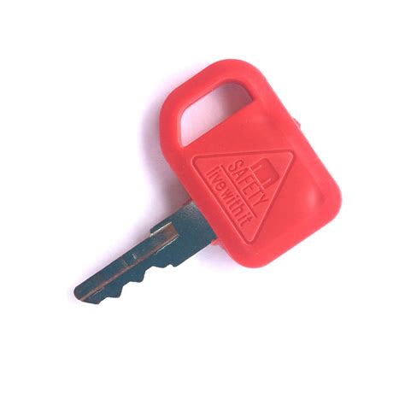
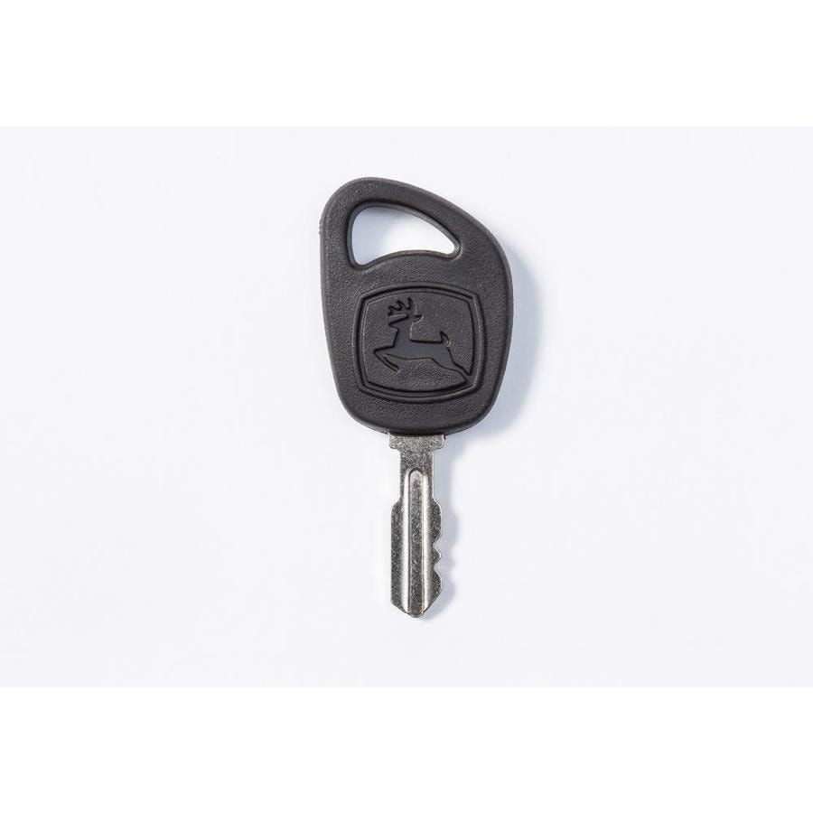
Vehicles With No Security
Skid Steers, Tractors, Lawnmowers
Universal Key
ATV's and UTV's
Pick the lock which only turns the battery on
Screwdriver

Slide 16
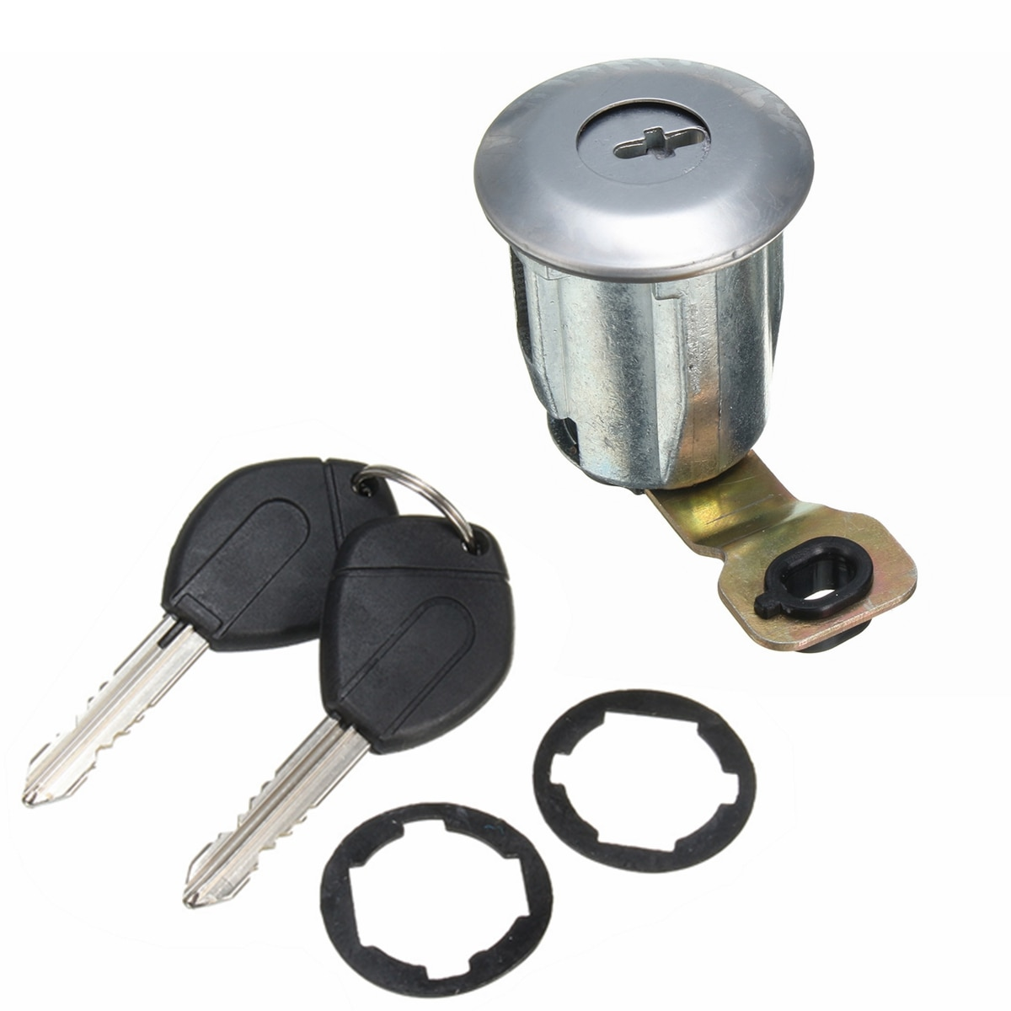
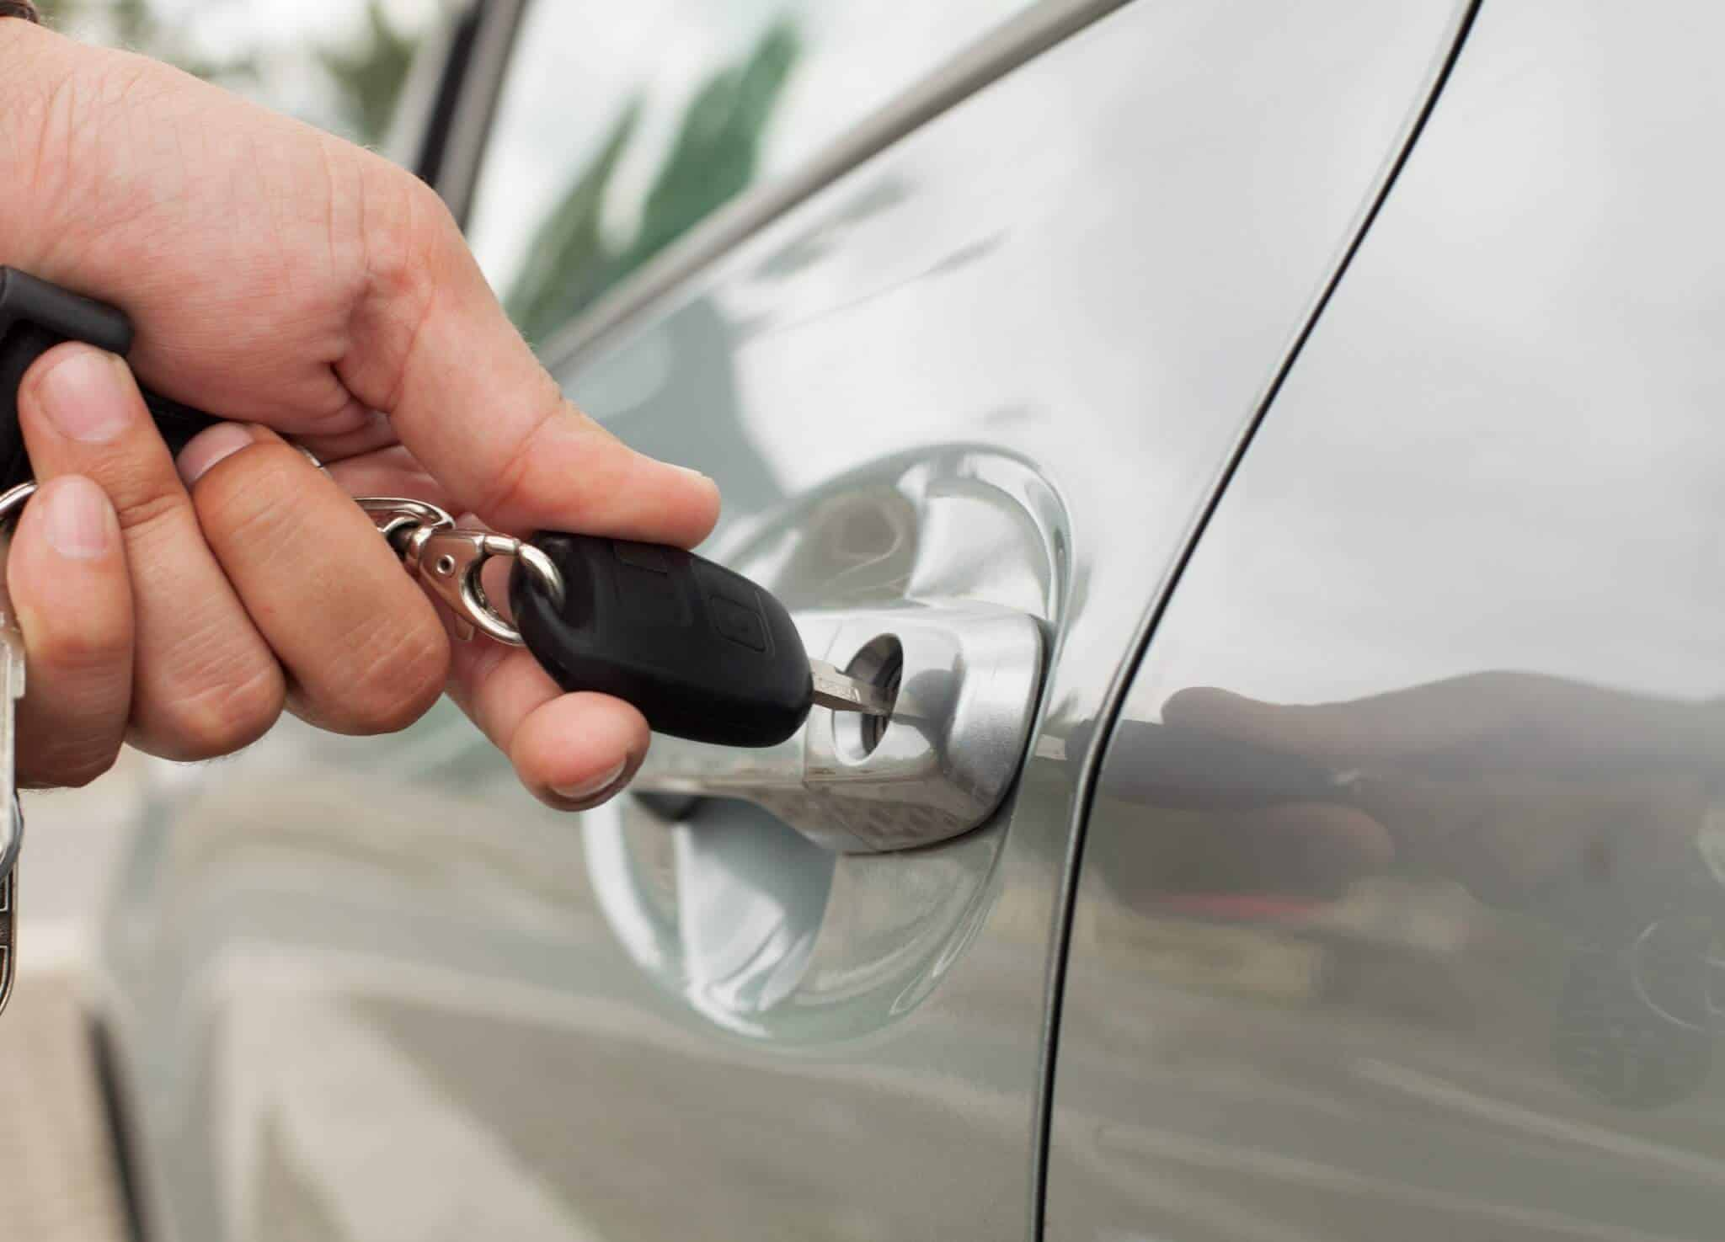
Manual Car Door Lock
Wafer Lock
Programmed Key Fob
Sensitive to Lock picks
Strip Easily

Slide 17


Keyless Entry
Unlock and Lock Signal
Copy and re-transmit it
Rolling and Non-Rolling
Signal Booster
Tricks the car that the key fob is near the car
Allows for unlocking and starting the engine

Slide 18
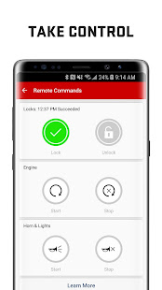
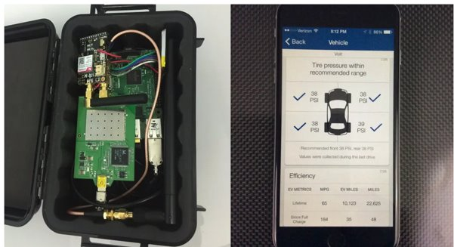
Mobile Start
Start, Stop, and Unlock the Vehicle
Track Location
Full control of the Car
Smartphone Key Fob technology

Slide 19


On-Star Attack
General Motors mobile assistant
5 years to fix full takeover 5 million cars
GM uses Verizon Servers
Connect to the system through Verizon's voice network
Copy an Mp3 file and reverse engineered it
Create a file that overflows the computer and allows complete access through iOS

Slide 20

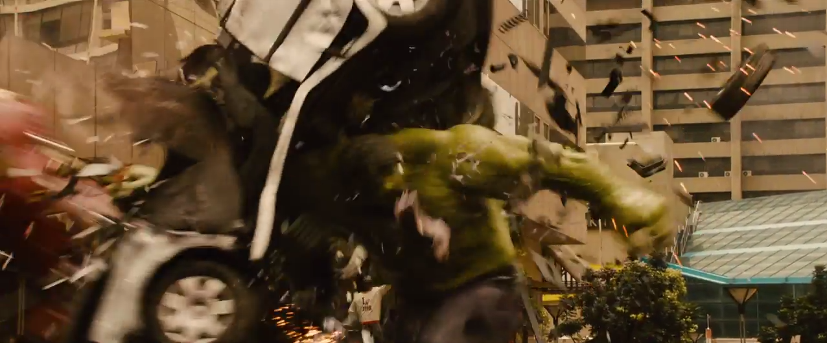
Prevention
Don’t leave keys near windows
Leave Car Locked
Secure your doors
Park in the garage

Slide 21

Handcuffs and houses
W/ Alec

Slide 22
Learning Objectives
How to break out of handcuffs
Alarm Systems

Slide 23
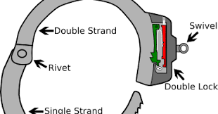
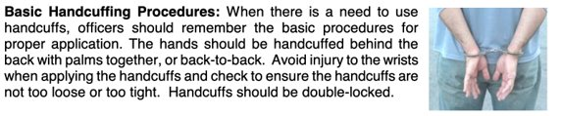
Handcuffs ;)
Proper Application?
Double lock

Slide 24
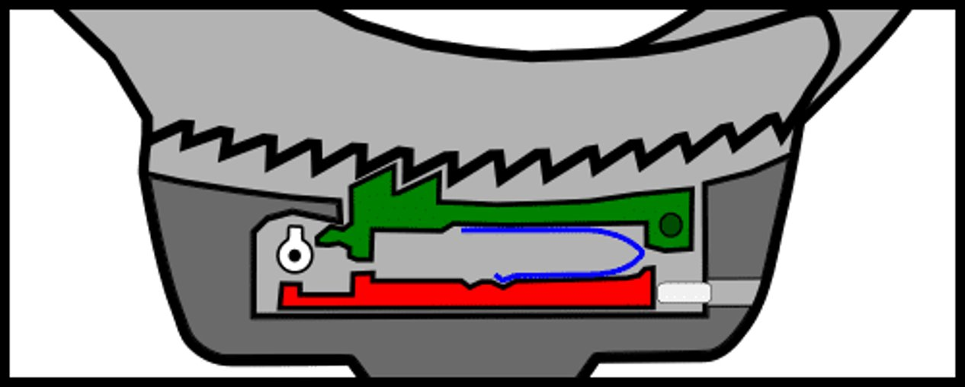
Defeat handcuffs
Bobby Pin

Slide 25

Defeat handcuffs
Shims

Slide 26
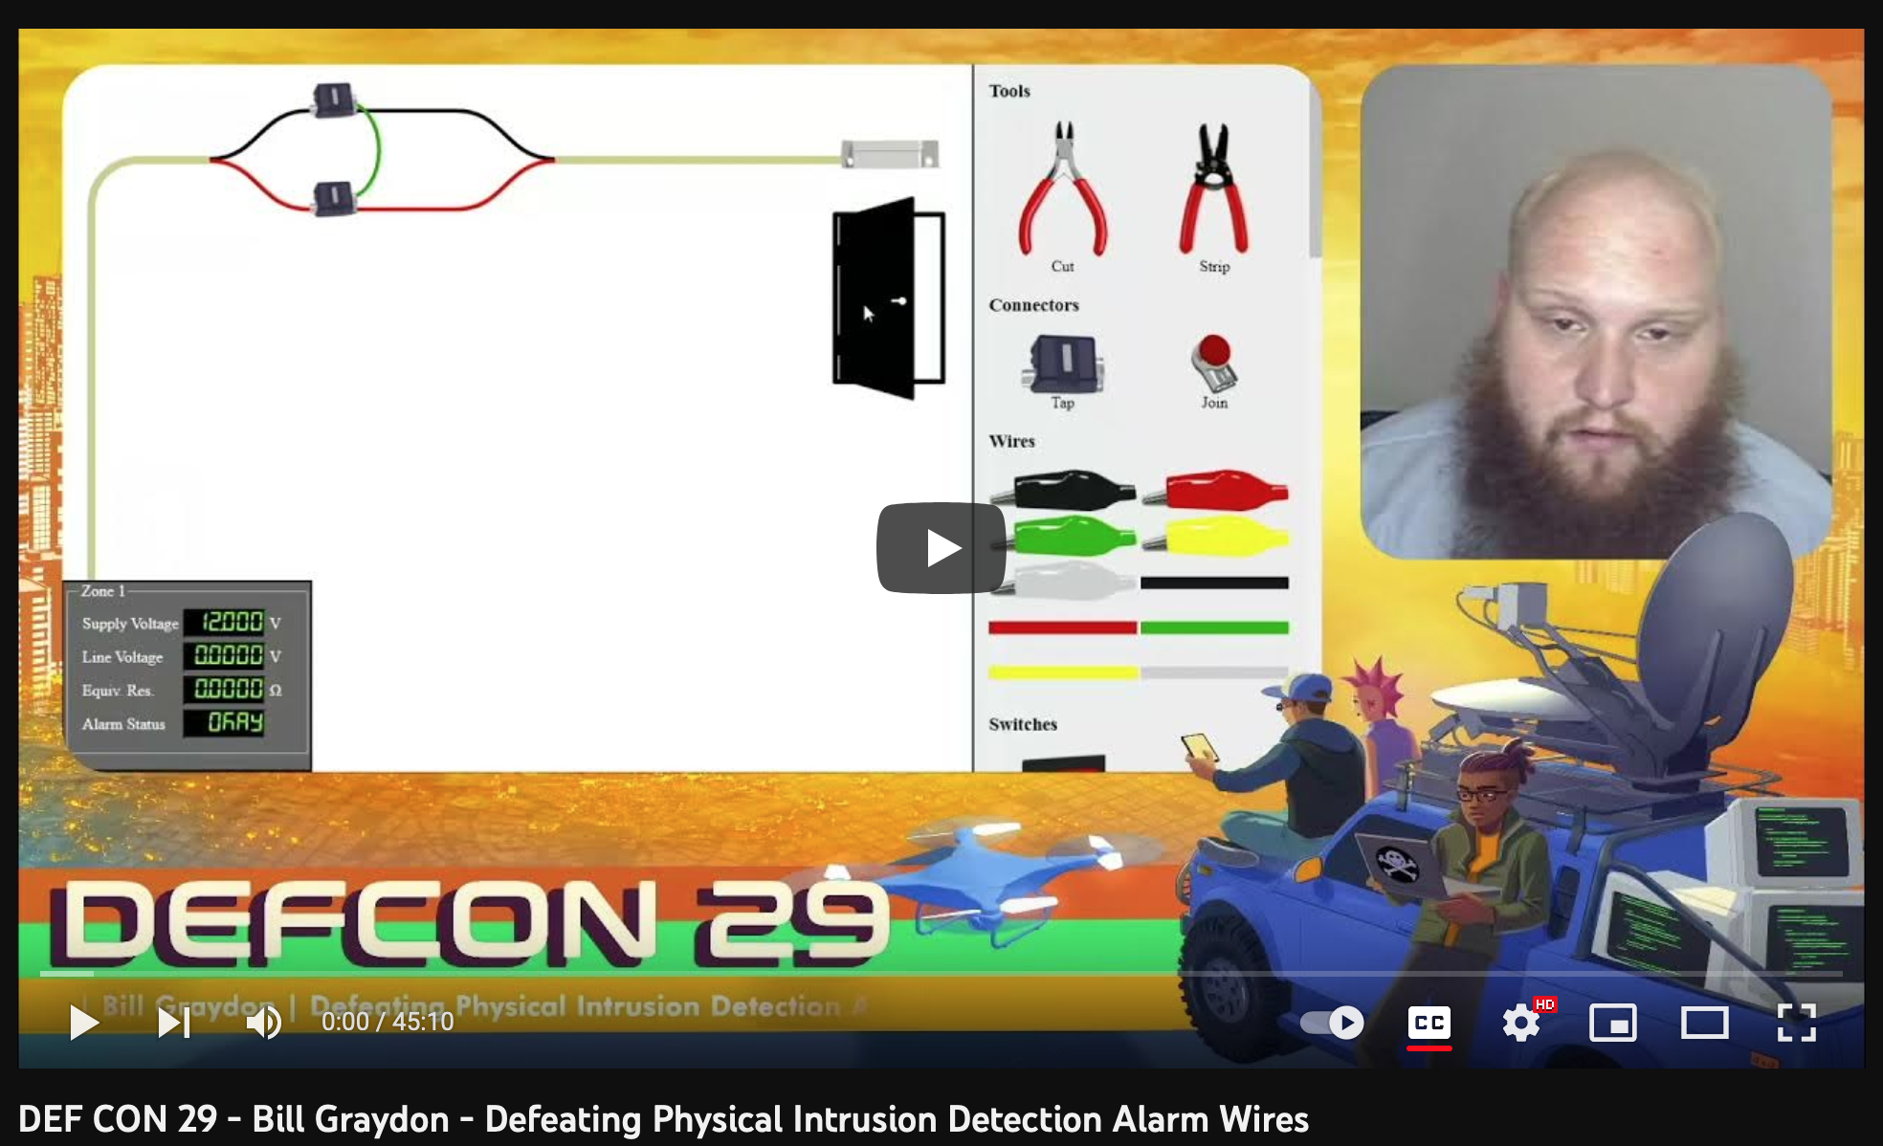

Alarms
Defcon 29:
Bill Graydon - Defeating Physical Intrusion Detection Alarm Wires
At home & at work

Slide 27
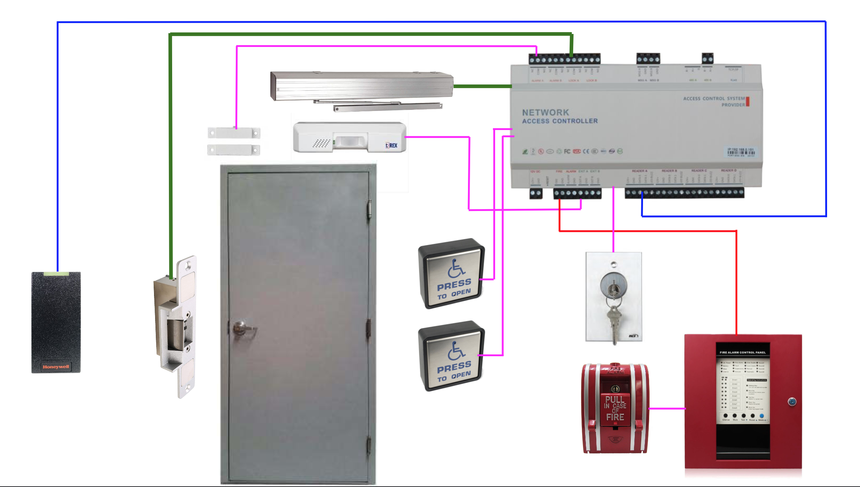
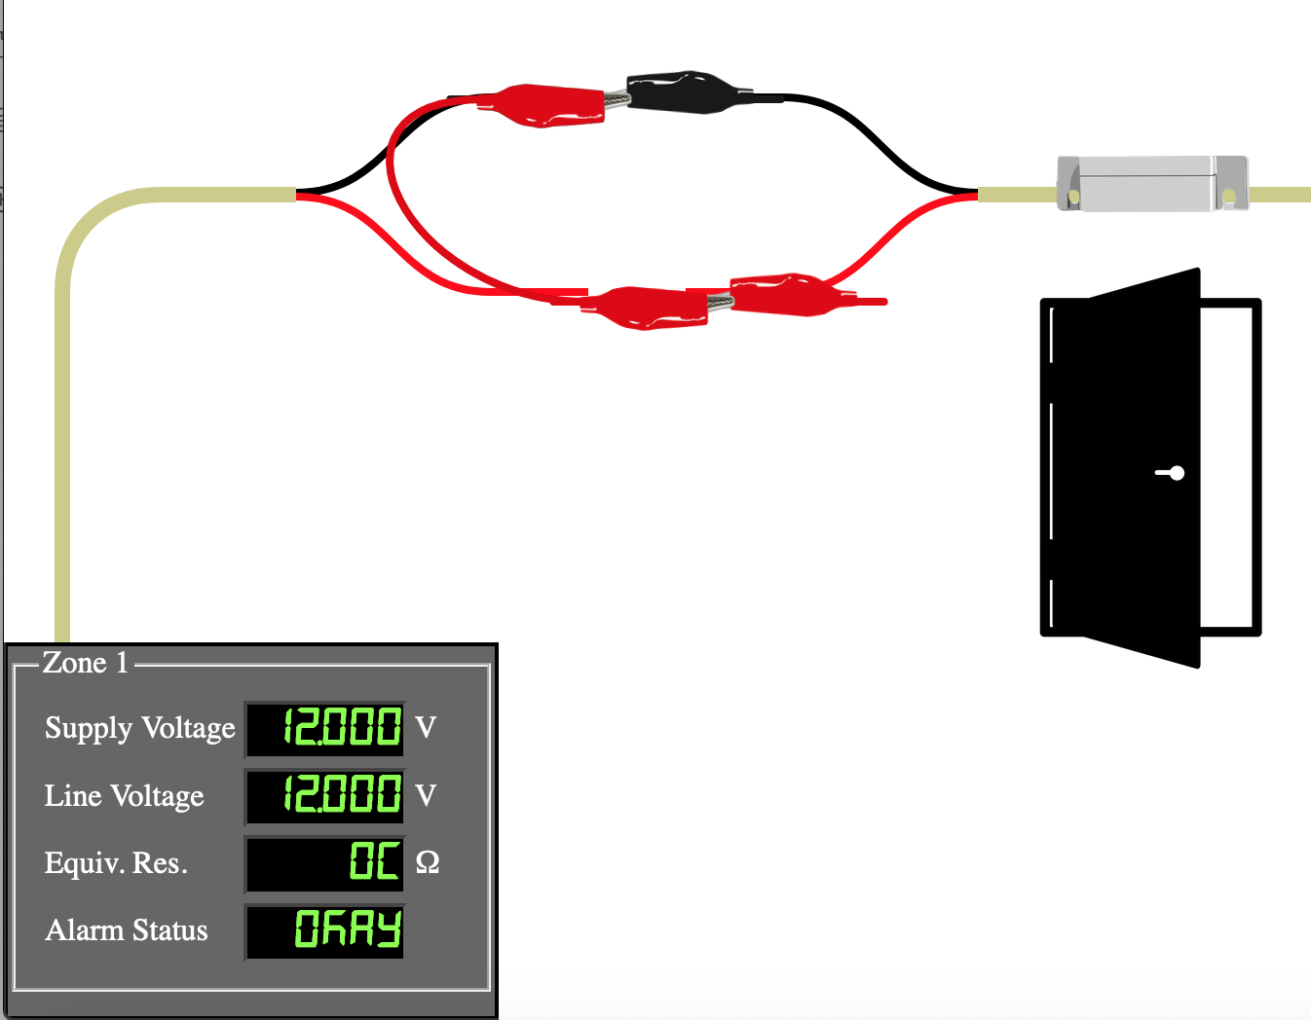
Bypass da alarm
https://www.bypassvillage.org/games/alarm_wire/

Slide 28
Use of alarms
Make noise, scare bad person
Indicator of issue
Alarm != Evidence; get a camera

Slide 29


Social Engineering w Jenna >:)
Physical Phishing and exploiting humans

Slide 30
Learning Objectives
What is Social Engineering?
Impersonating someone
Building a narrative
I'm in
Prevention

Slide 31
What is Social Engineering?
Exploiting humans to gain entry or information
Humans can be easily manipulated by taking advantage of their natural inclination
Use social norms to your advantage
If your emotions are running high, you are more likely to make a rash decision

Slide 32
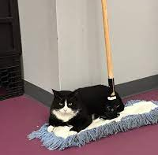
Impersonating Someone
Acting like you belong when you really don't
Essentially creating a character and acting out the role
Fake IT guy, janitor, etc.
Tailgating
This happens all the time even here at PSU, especially in the dorms
Even more susceptible if your hands are full
Coffee cups
The key is to act with confidence

Slide 33
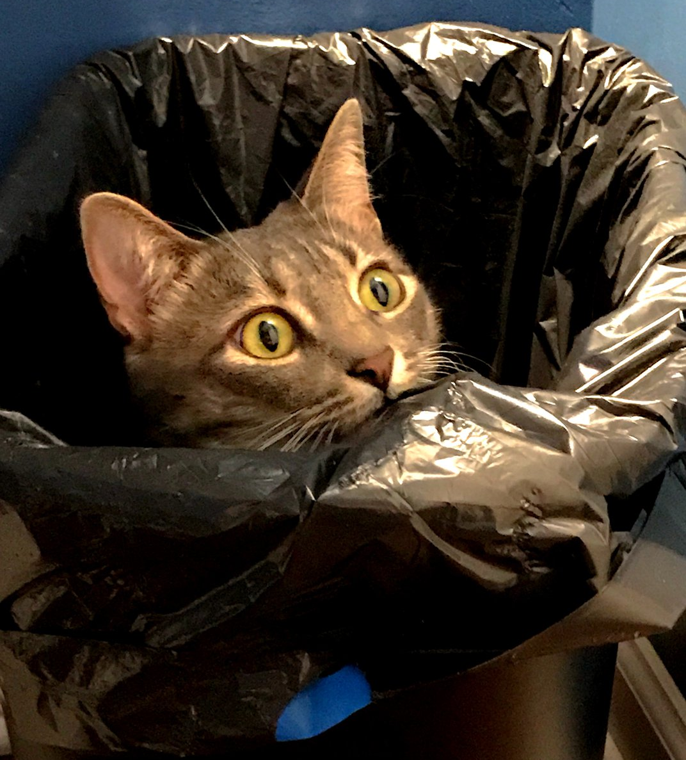
Building a Narrative
More information = better narrative
Dumpster diving
Sensitive information might not have been disposed of properly
Can find device serial numbers, passwords, etc.
Shoulder surfing
Can be from up close or from a distance
These can help build a narrative

Slide 34
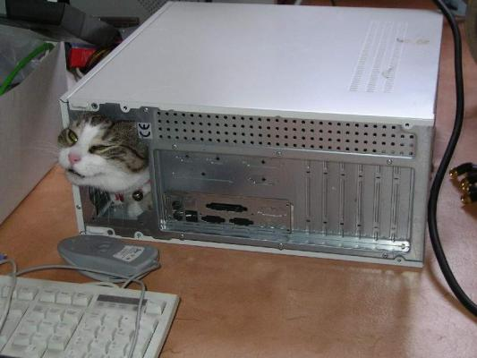
I'm in
After obtaining entry into a building, what next?
Steal information
Employee workstations left unlocked
Creds on post-its
Sensitive documents on desks
Cause chaos
Rubber duckies
Physical access to hardware

Slide 35
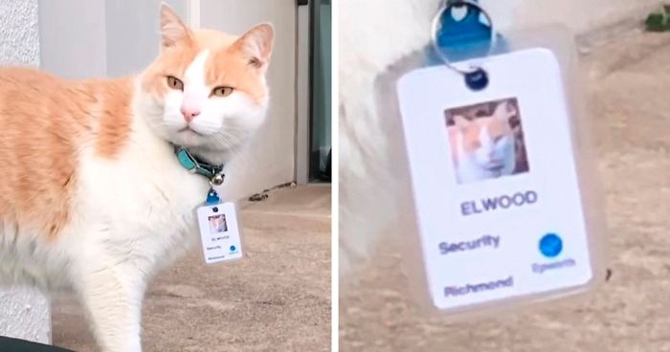
Prevention
Security is all about knowing who to trust
Double check ID/identities
Don't be afraid to question suspicious actors
Make sure information is disposed of properly
Keep desks and workspaces clear
Make others aware
Trust your gut

Slide 36
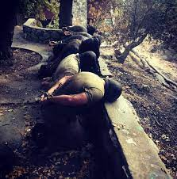

SERE w Korbin ;)
Survival, Evasion, Resistance, and Escape

Slide 37
What is SERE?
Is a course for people that are at extreme risk of capture and exploitation.
Aircrew, Special Operations, Intelligence, and Diplomatic Personnel
SERE was formally recognized as a course after the Vietnam War.

Slide 38
What is taught?
Survival
How to survive in any biome.
Evasion
How to evade capture in given setting.
Resistance
How to resist interrogation tactics.
Escape
How to either talk or break out of where you are being held.

